Slide 1






Long Distance Video Streaming
Zachary Howe and Somaralyz Grullon
Collage of Avation and Collage of Engineering
Mentor: Dr. Yabin Liao

Slide 2
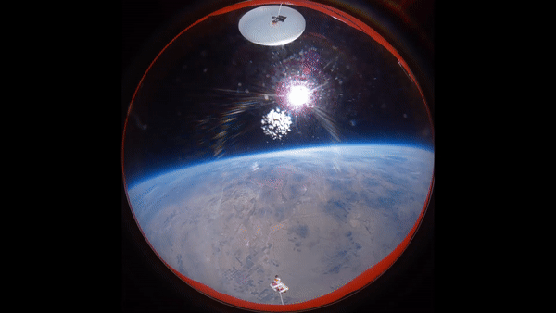

Mission Overview
During the Fall and Spring Launches the Goal was to Implement live streaming video and telemetry using the Industry, Science, Medical (ISM) band. The goal was to get live video and see the orientation in real time.

Slide 3

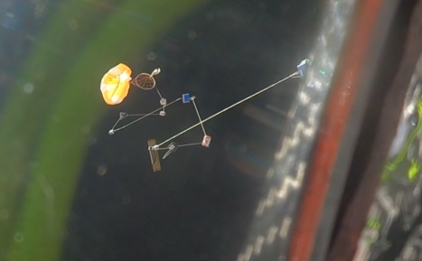
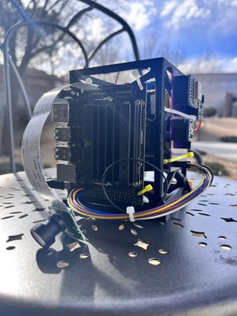
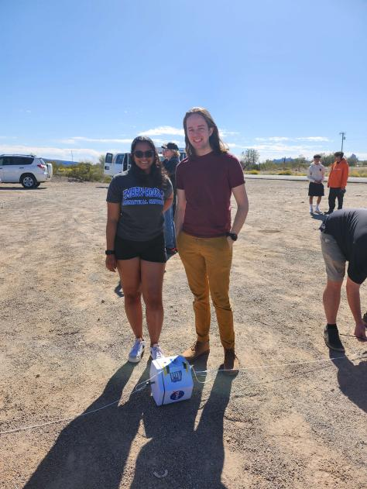
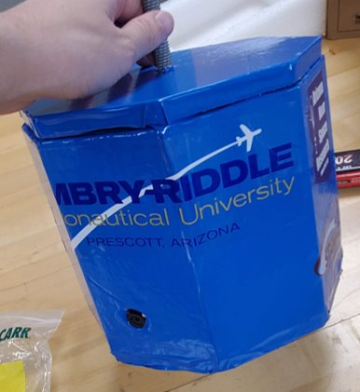
The Payloads

Slide 4
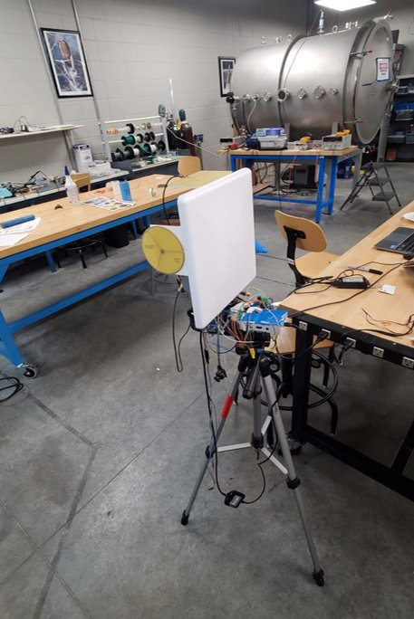
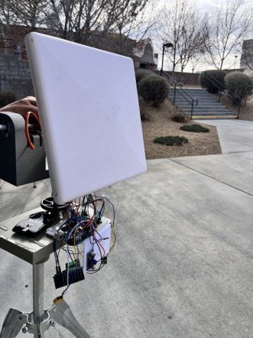
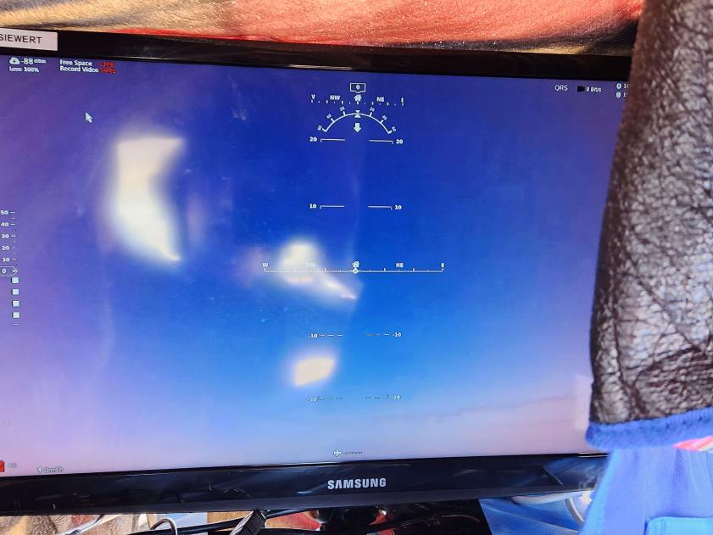
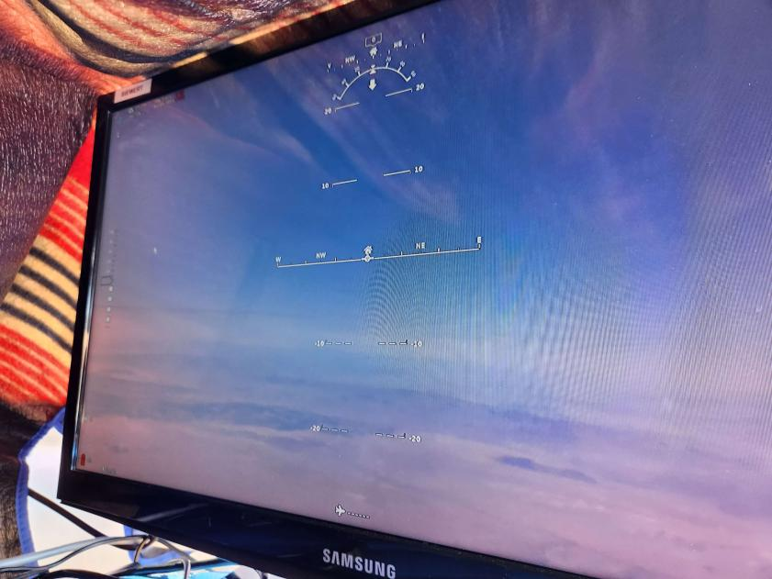
Ground Station
2.5 GHz Pannel antenna
Pan and tilt abilities
Raspberry pi runs the monitor

Slide 5
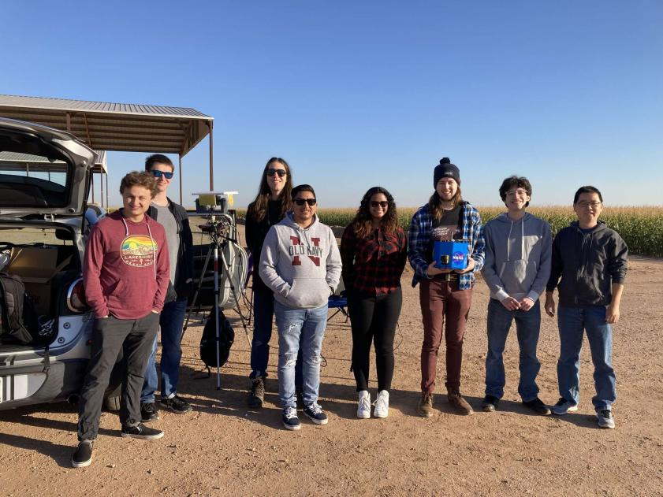
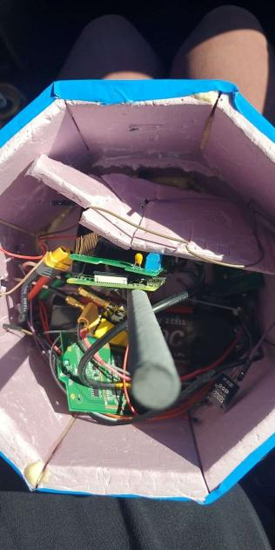
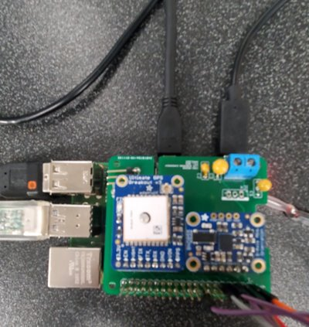
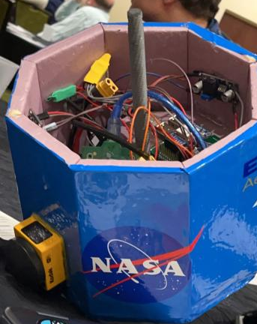
Fall Launch

Slide 6
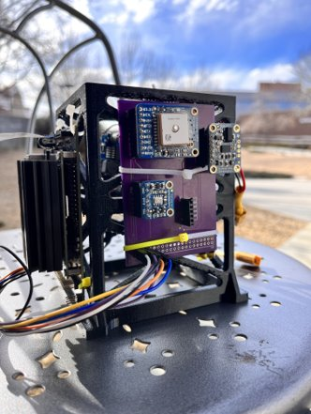
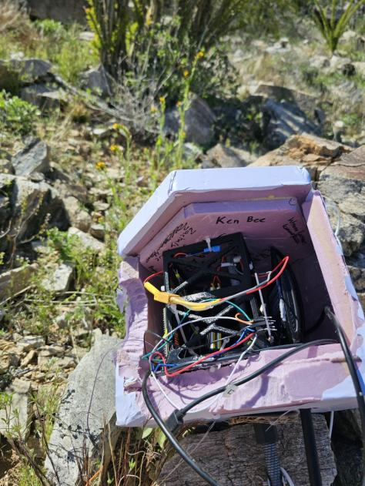
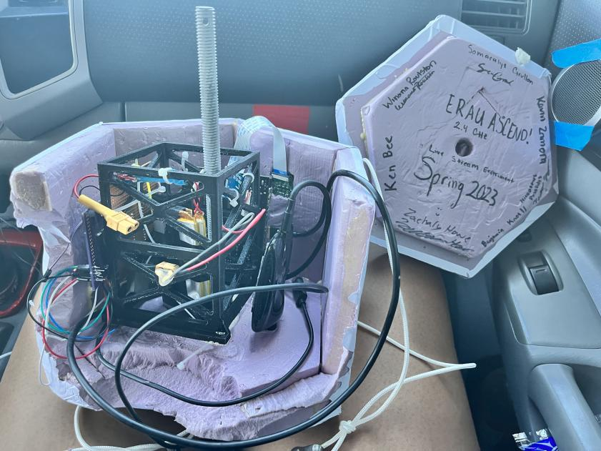
Spring Launch

Slide 7
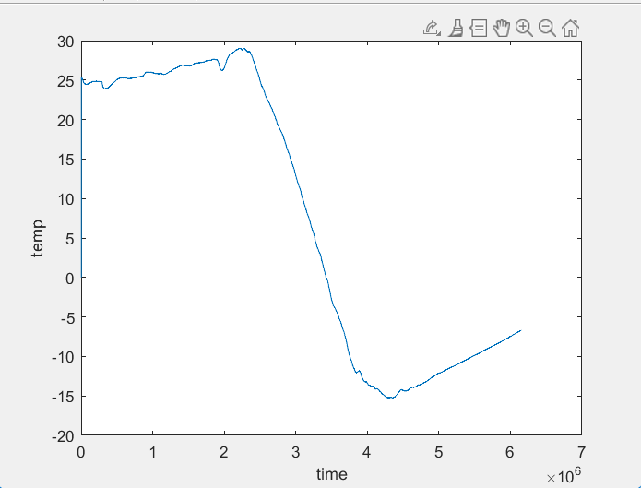
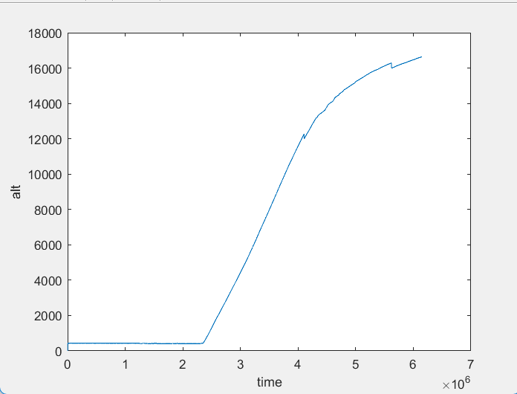
Figures
75~ Minutes is Burst

Slide 8
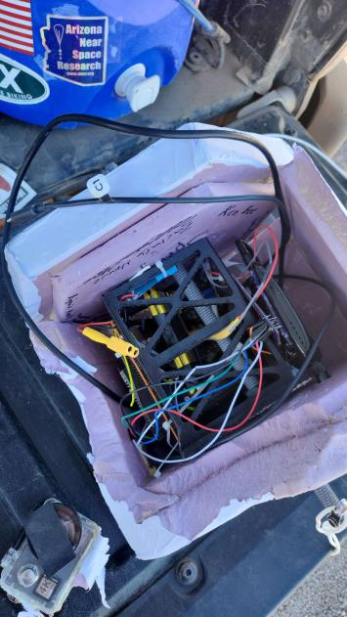
ASCEND Going Forward
We have concluded that the wall with the camera has the least structural integrity so we will think of ways to add better structure

